Slide 1

I implemented AWS WAF in front of the application load balancer using AWS managed rule groups to provide baseline web-layer protection against common attack patterns.

Slide 2
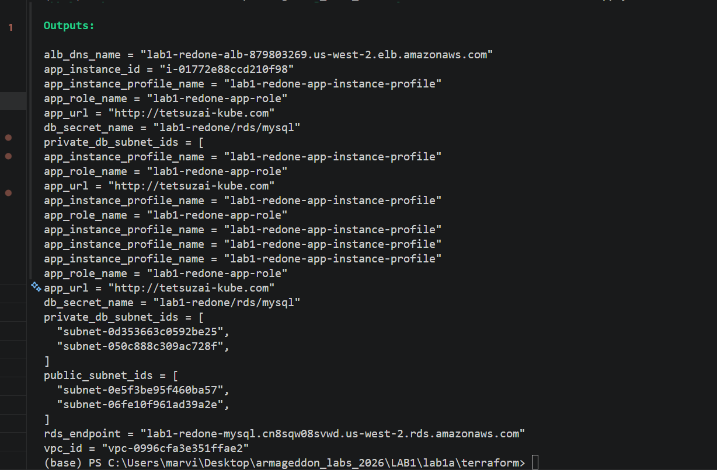

Slide 3
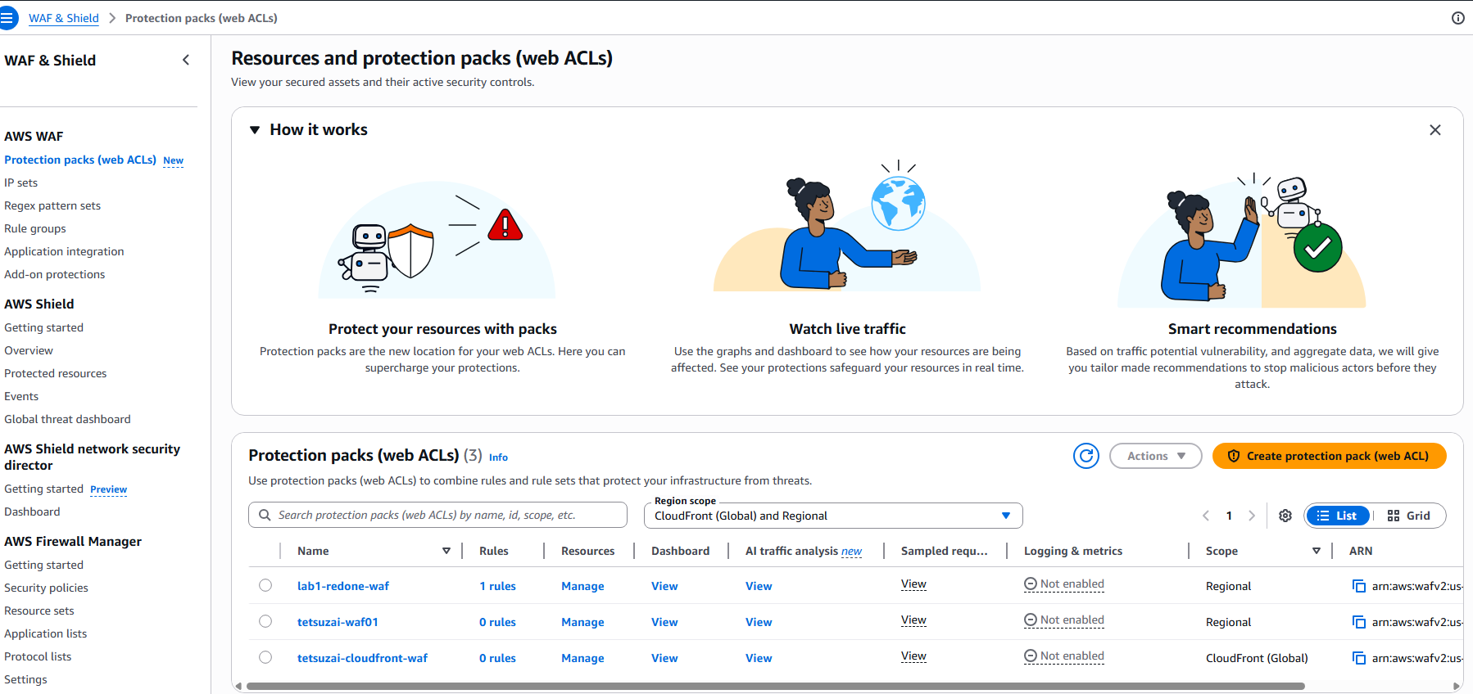

Slide 4
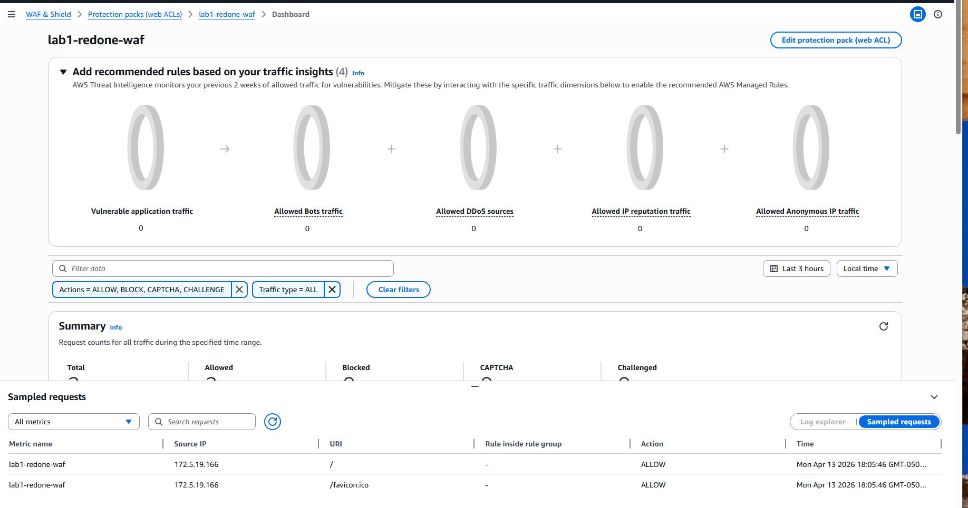

Slide 5
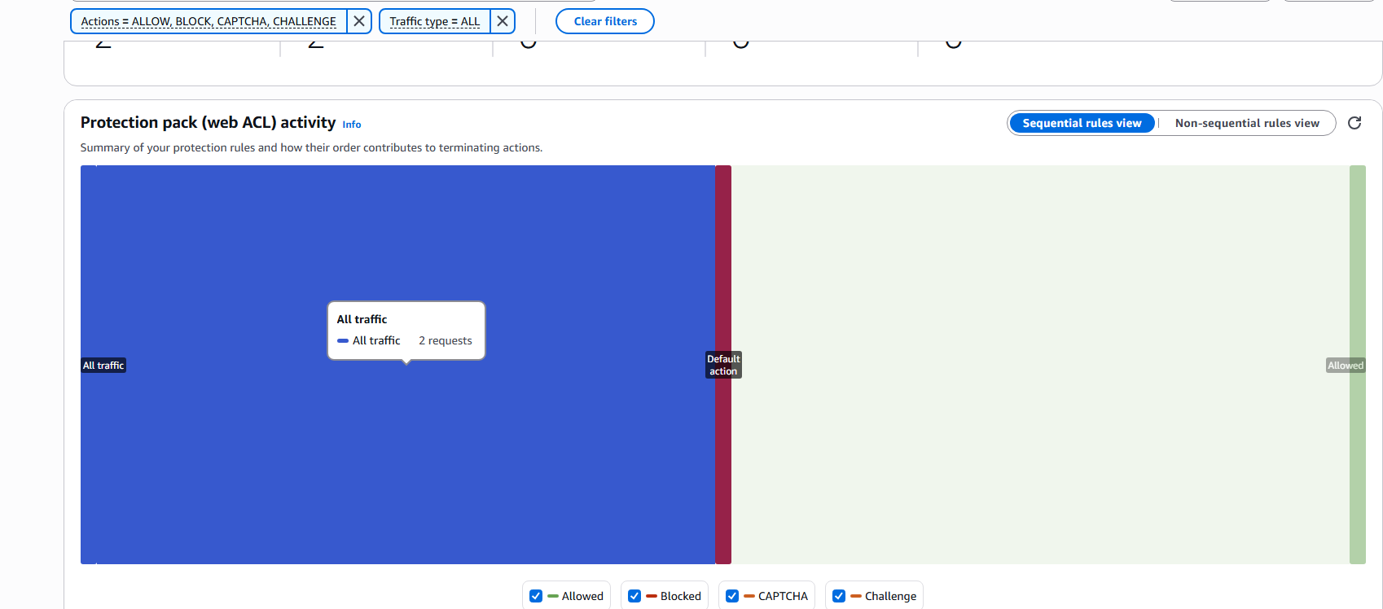

Slide 6
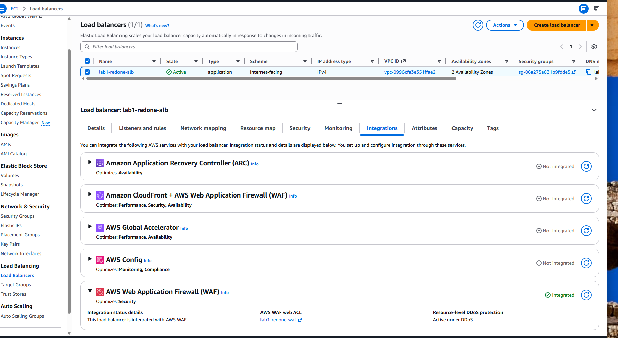

Slide 7
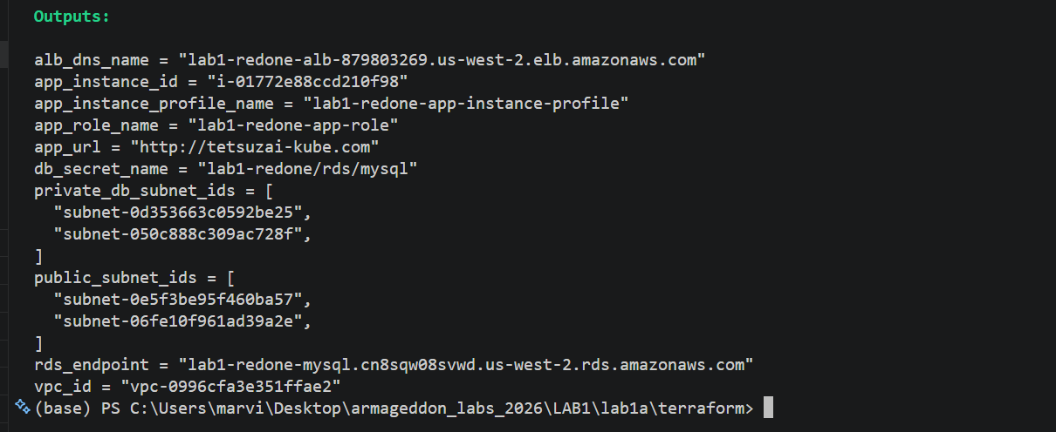
dashboard

Slide 8


Slide 9
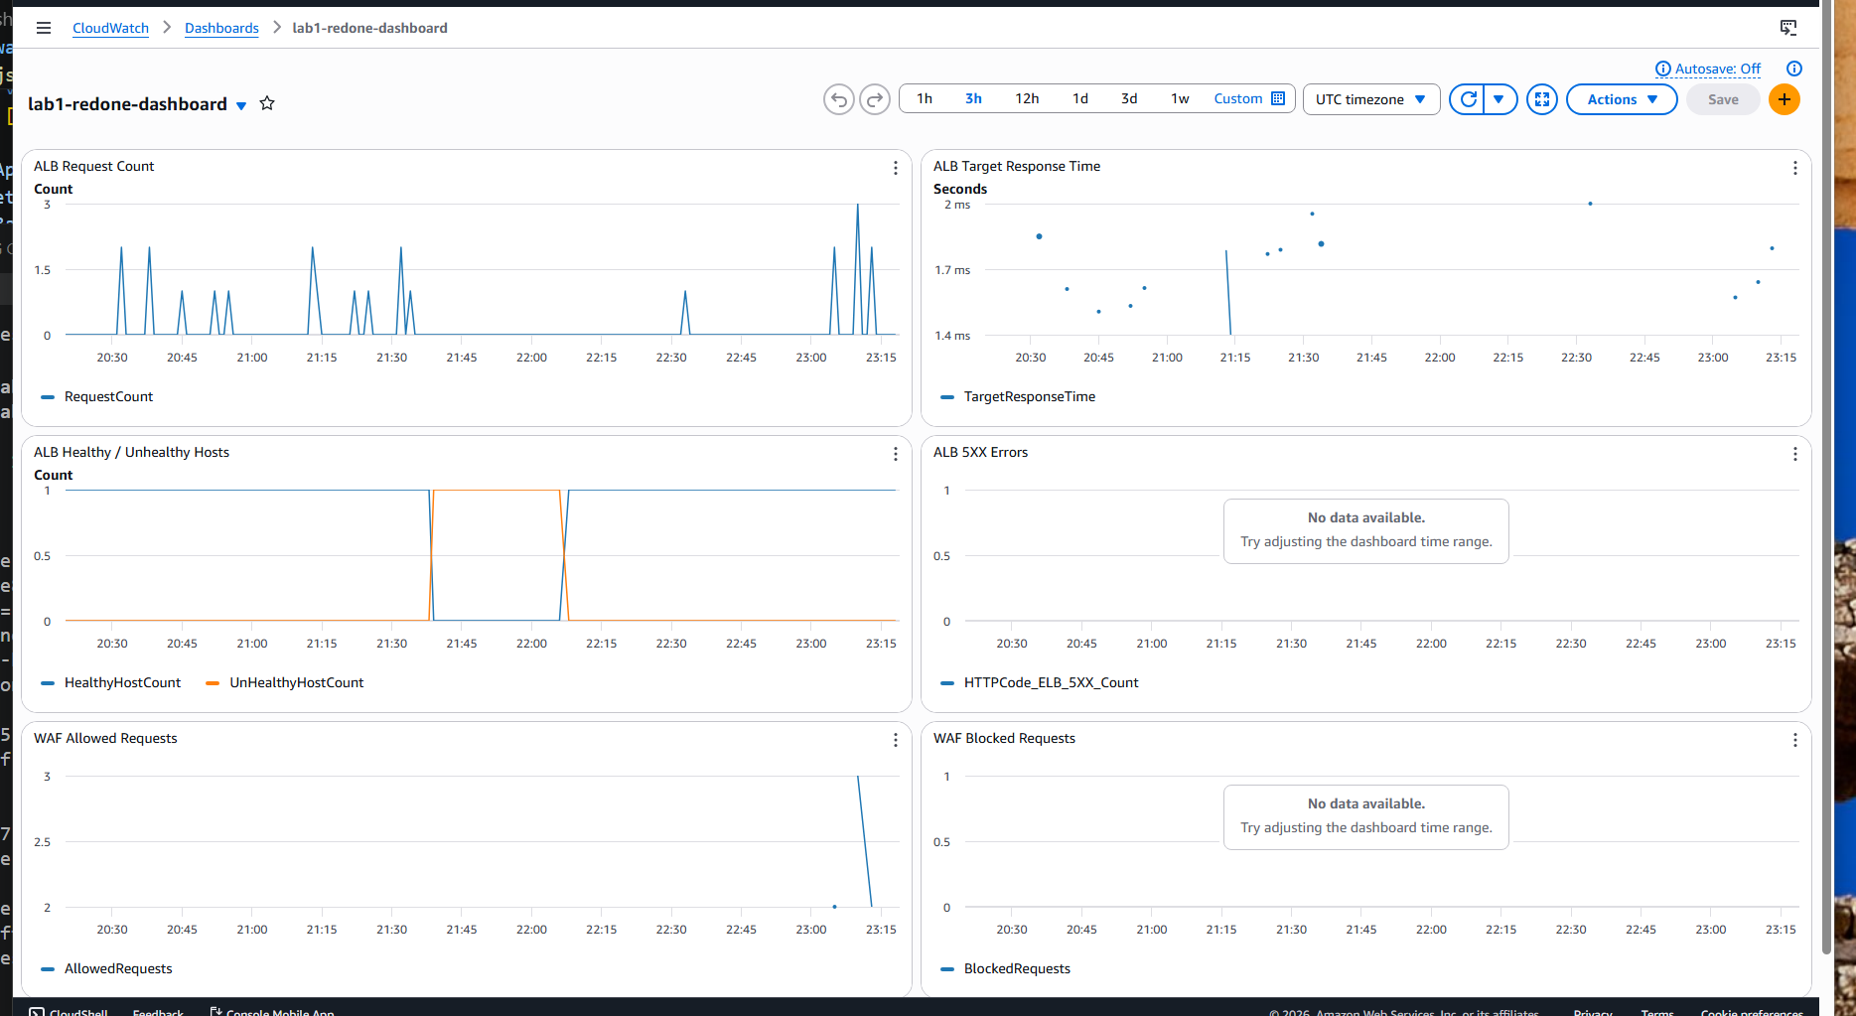

Slide 10
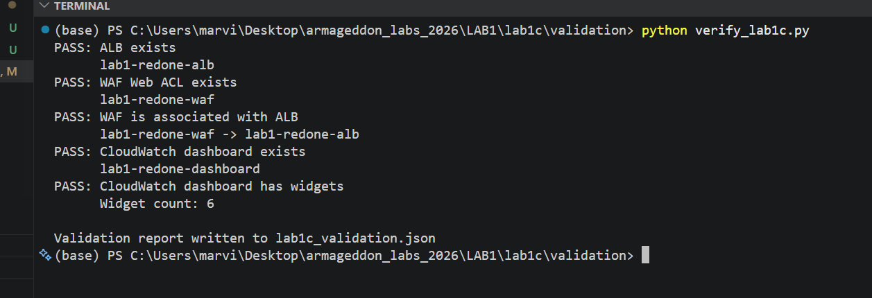
Python verification

Slide 11
